Slide 1

Lost-Contract Client Characteristics Analysis
Random Forest
Active
Important Variables
Volume 2011-2015
Segment
Pricing_index11 & 13
Outpatient Gross Revenue
Outreach
Operating Revenue
Lost Contract
Methods
Analytical Method
Active Clients with Highest Probabilities to Drop
Random Forest Model
Black-box algorithm
Importance plot
Ridge Regression:
Accuracy: 96.59%
Other methods: logistic regression
Client ID:2488 3798 4742 1573 4811 1873 3995 4584 3022 681
Random Forest model plus ridge regression generates the best result.
Team 22

Slide 2
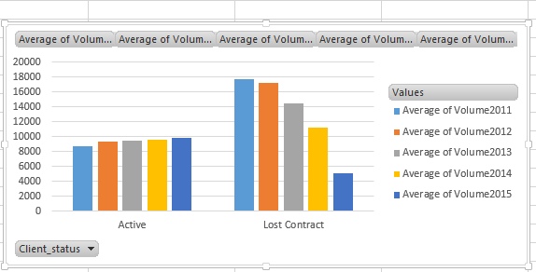
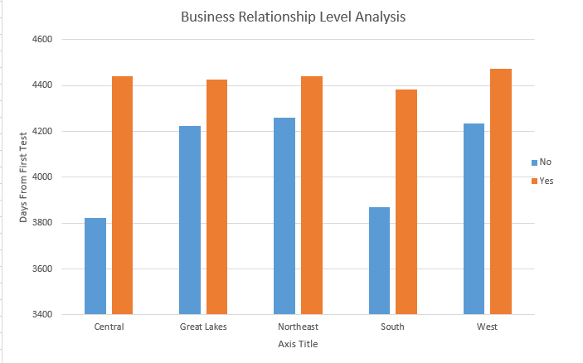
Lost-Contract Client Insights I
Volume Trends Analysis
Business Relation Analysis
Business Trends
Key Characteristics of Lost-contract Client
Explanation
Volumes are constantly decreasing
Old Clients in Central and South are more likely to be lost
A lost-contract client is more likely can to be from Northeast (Next Slide)
Variable First_Client_month is modified as the number of days from now. The average values of this variable for Lost-contract clients are significant higher in Central and South. It indicates that the clients which have longer business relation with Mayo are more likely to quit.
Data indicates that the volume is an useful predictor when tracking relationship with clients. Further analysis about client retention in Central and South should be implemented to avoid further lose with old customers.
Team 22

Slide 3

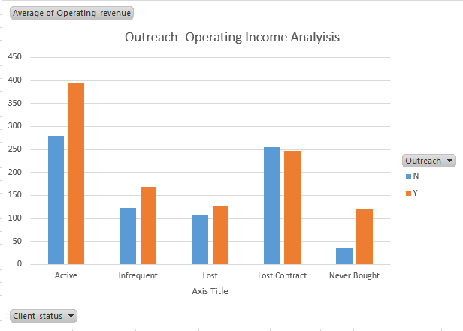
Lost-Contract Client Insights II
Lost-Contract Rate
Lost-Contract/Active Client rate of each division is calculated
8.33%
The rate is much higher in Northeast, compared with an average of 3.53% among other divisions
Outreach-Operating Income Analysis
Comparison
Learning
Productivity
Operating Income
Teaching
Assessment
Average operation income for clients who do outreach is lower only in lost-contract clients group
Infrastructure
Further analysis on clients in northeast should be conducted to understand the high quit rate. Industry standards about operating income could be set so that if a client who does outreach, its operating income could be compared with benchmarks to predict.
Team 22

Slide 4

Active Clients Analysis
Identify significant attributes to movements in volume based on random forest
Significant drops
Set two new variables: yearly increase amount
yearly increase rate
Define significant criterion:
> 100
> 0.3
Extract top 5 important variables from random forest model using varImpPlot() for each year
Significant increases
Set two new variables:
yearly decrease amount
yearly decrease rate
Define significant criterion:
< (-100)
< (-0.3)
Extract top 5 important variables from random forest model using varImpPlot() for each year
Key important variable for analysis
1
Pricing_index rate of change (2011 – 2013)
2
Segment
3
Acuity_index
Model indicates that among Active Clients, pricing_index change, segment and acuity_index are highly correlated to significant movements in volume
Team 22

Slide 5
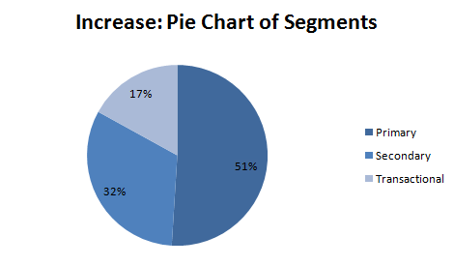
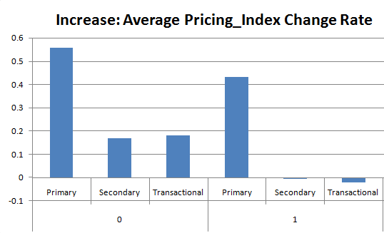
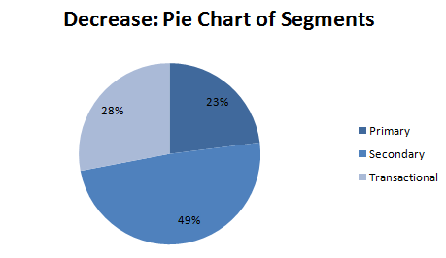
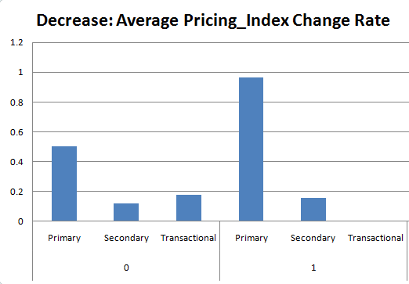
Active Clients Insights
Segments Distribution
Pricing_Index Distribution
Key Characteristics
51% significant increase active clients fall into Primary segment
For Secondary and Transaction segment, decrease rate in pricing_index leads to significant increase
49% significant decrease active clients fall into secondary segment
For Primary segment, increase rate in pricing_index leads to significant decrease
Primary clients are more likely to significantly increase volume; Secondary and Transaction clients with lower pricing_index are more likely to increase volume
Secondary clients are more likely to significantly decrease volume; Primary clients with higher pricing_index are more likely to decrease volume
Team 22

Slide 6
Predicted Client Status Analysis
Classification
Result
Supervised learning in classified data
Classification accuracy
KNN: 70%
LDA: 75%
Linear Discriminant Analysis
K-Nearest Neighbor
Predict Revenue Potential
Result: R-Squared
Eliminate outliers
Primary:0.69
Secondary:0.59
Transactional: 0.58
Fit all data: 0.61
Box-cox transformation: log
Linear regression with stepwise and ridge
Classify data using K-Nearest Neighbor model and predict the revenue potential by modified linear regression.
Team 22

Slide 7
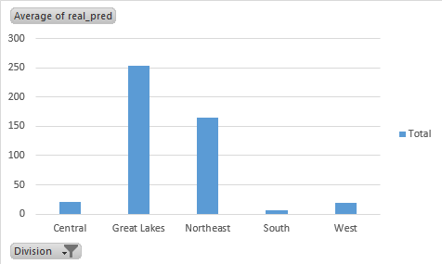
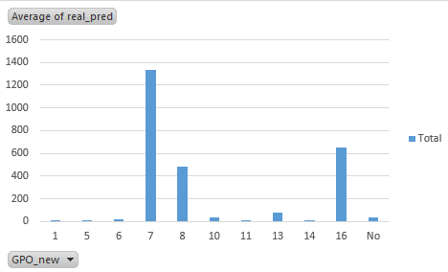
Predicted Client Insight
Analysis on Potential Clients’ Division, Group Purchase Organization (GPO), and Client Status
Division
GPO
Client Status
Among predicted clients, Great Lakes and Northeast have the highest average volume
Market strategies may be weighted along these two divisions
Predicted clients in group 7,8,16 have high average volume
Client relation may be researched among the three groups for potential business
Among the predicted clients, 66.28% are transactional, 33.42% are primary, and 0.2% are secondary.
Although primary clients are not the largest group in potential clients, they have the largest total predicted volume.
Mayo should focus more on clients if they are predicted as primary
Future client status and volume of never-bought clients are analyzed. Base on estimated average volume, Mayo should focus more on Great Lake and Northeastern division, GPO 7, 8 and 16 and clients with predicted status as primary.
Team 22

